Slide 1
Elm Fullstack / `elm-fs`
full-stack web apps made simple
https://github.com/elm-fullstack/elm-fullstack

Slide 2
Why Elm Fullstack?
Simplify State management on backend
Compared to traditional architectures: No accidental complexity for interface between database and application server.
Zero app code for persistence: Elm app state is automatically persisted and restored.
Migration is just an Elm function mapping from old state type to new state type.
Simplify serialization between backend and frontend(s)
Avoid bugs in (de)serialization code: Generate it automatically.
Simplify deployment and operation
Dedicated command-line interface (`elm-fs`) for common tasks in operation.
Common interface to integrate third-party components
Volatile Hosts work analogous to ‘ports’ in frontend/web apps.

Slide 3
Elm Fullstack - Applications in 2021
Online Multiplayer Game
DRTS Game - real-time strategy game (matchmaking, leaderboards, chat) - https://drtsgame.com
SaaS Backend
BotLab - reactor (usage-based billing, app insights, artifact catalog, integrating other clients via HTTP API) - https://botlab.org
Elm Editor
Beginner-friendly editor for developing Elm programs - https://elm-editor.com

Slide 4
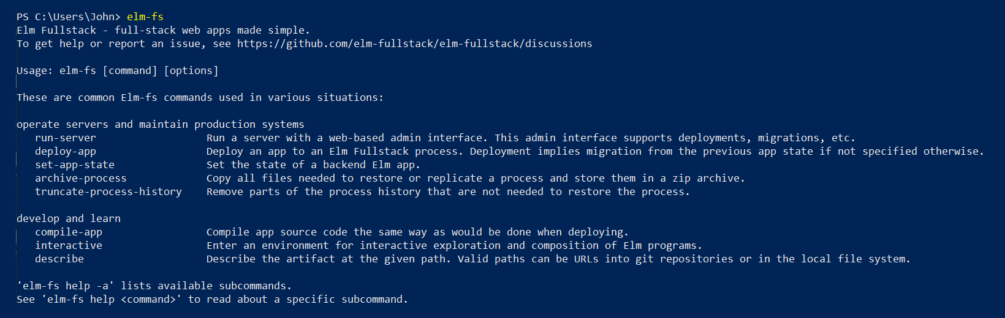
Elm Fullstack - User Interface in 2021
Single executable file combines functionality in a command-line interface:

Slide 5
Elm Fullstack - User Interface in 2021
Single executable file combines functionality in a command-line interface:
elm-fs run-server
Choose HTTP ports, admin password, store for persisting, etc.
elm-fs deploy-app
Deploy app on a server. Migrations also happen here.
elm-fs set-app-state
Quick way to modify backend state.
elm-fs archive-process
elm-fs compile-app
See results of the lowering stage of compilation.
elm-fs ....

Slide 6
Elm Fullstack - Architecture and Implementation in 2021
App compilation as lowering
Input is file tree - output is file tree + diagnostics
Compilation does not change types in the Elm programs, so we can use standard Elm tooling for example in editors.
Helps understand how compilation works: View difference between original and lowered app code.
Forward compilation output to `elm make`
Run javascript on common javascript engine V8

Slide 7
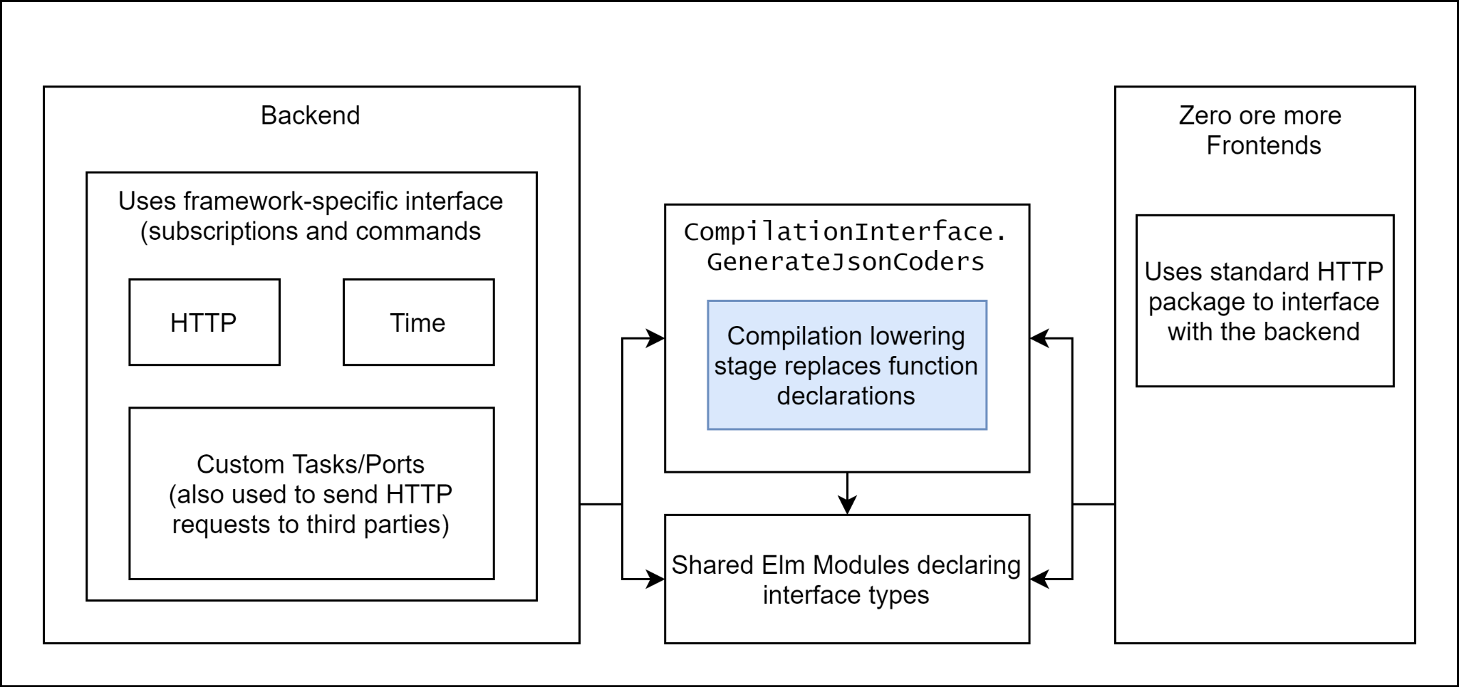
Elm Fullstack - Architecture and Implementation in 2021
Zooming in on Interface between Backend and Frontend(s)

Slide 8
Elm Fullstack - Limitations in 2021
No implementation for macOS - need to use docker as workaround
No support for functions in backend state type
Host interface / event type is work in progress (request/response model)
Optimizations for runtime expenses still to be done. Largest app state currently in production is 30 MB. Runtime is not yet optimized for response times.

Slide 9

Elm Fullstack - Contact
Source code, guides, documentation, example apps: https://github.com/elm-fullstack/elm-fullstack
Michael - michael@michaelrätzel.com

